Slide 1
Medical Q/A System
Jinu Nyachhyon

Slide 2
Data Collection
10 Medical Treatment Guideline PDFs
Asthama
Breast Cancer
Celiac Disease
Diabetes
First Aid
Heart Disease
Lung Disease
Migraine
Skin Disease
Stroke

Slide 3
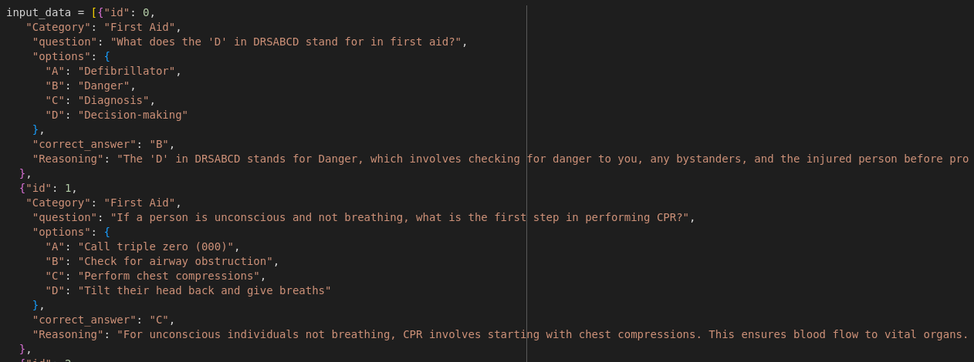
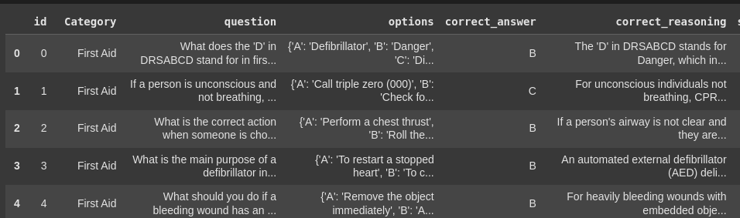
Data Collection
Dataset
id
Category
Question
Options
Correct Answer
Reasoning

Slide 4
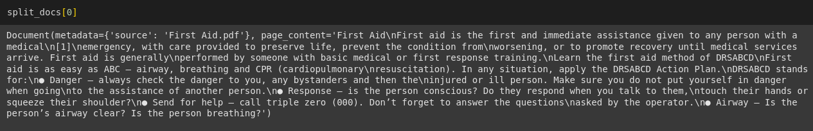
Indexing
Load PDFs and Convert to Documents
Split Documents into Chunks
Embed the Chunks and Add to VectorStore

Slide 5
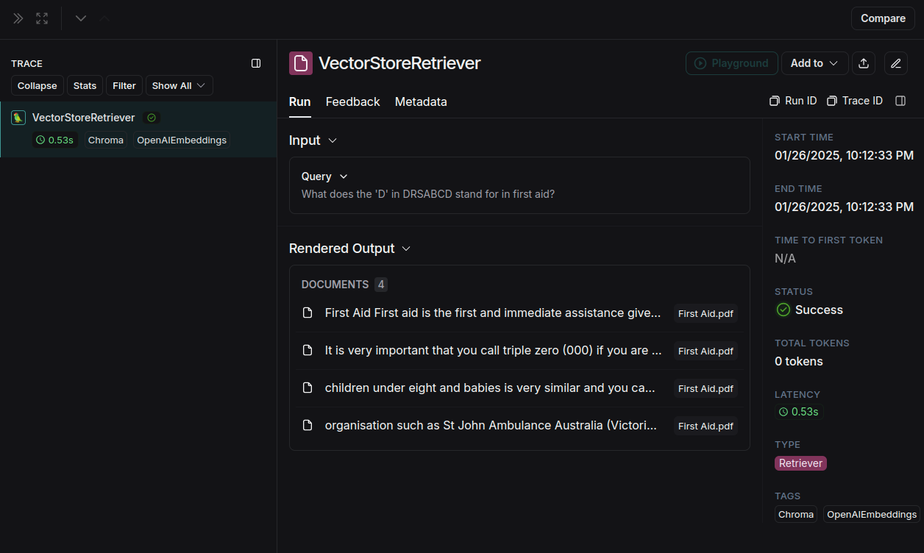
Retrieval
VectorStore as Retriever

Slide 6
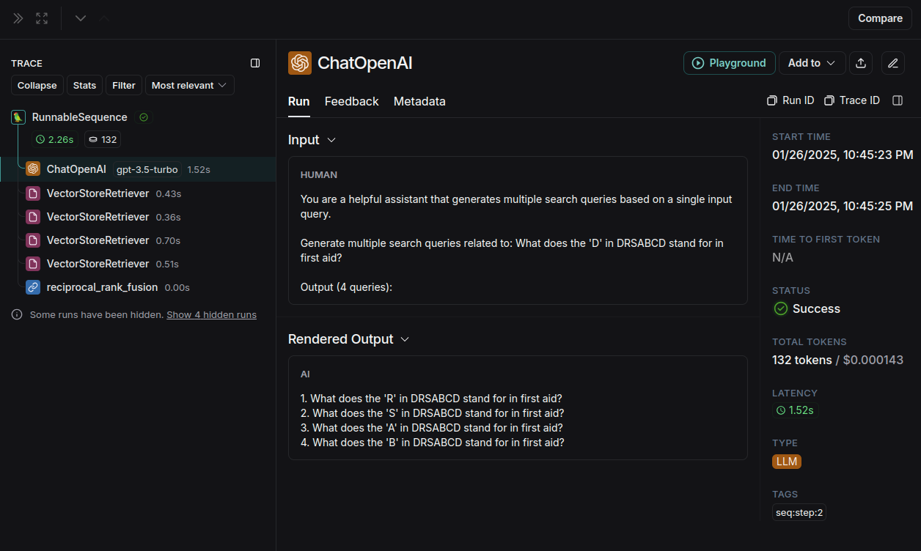
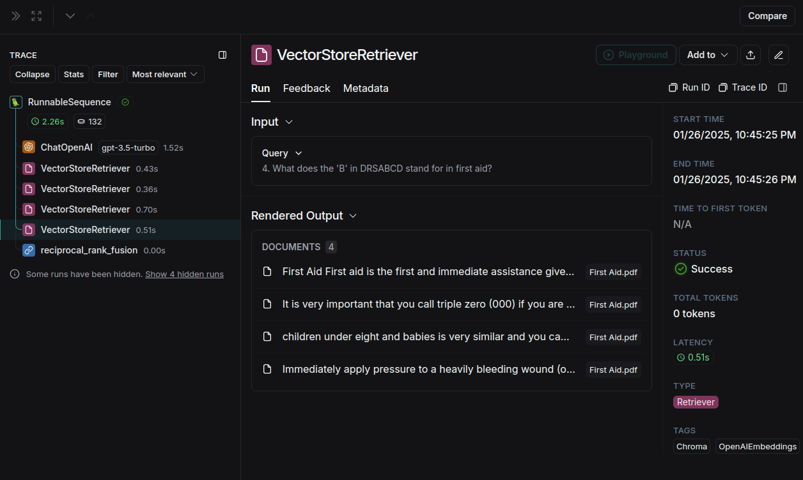
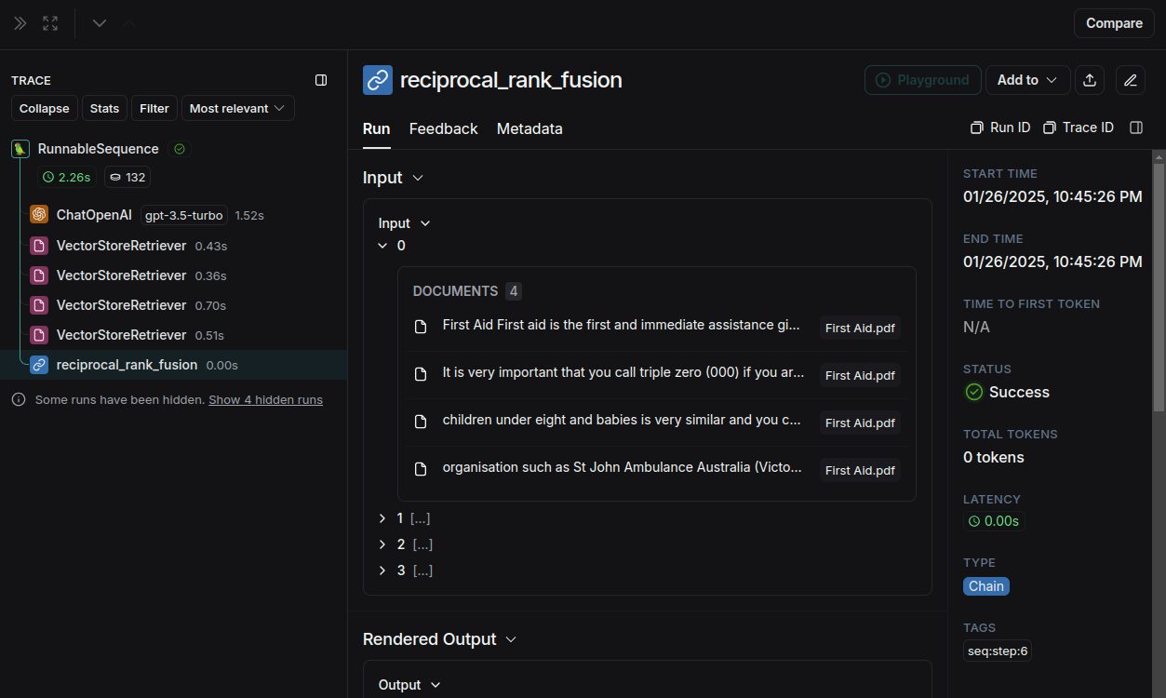
Generation
RAG-Fusion + Reciprocal Ranking
(Process: Decompose one question into four sub-queries, retrieve relevant documents for each, rank them based on relevance while ensuring uniqueness, and return the ranked documents.)
Step 1:
Step 2:
Step 3:

Slide 7
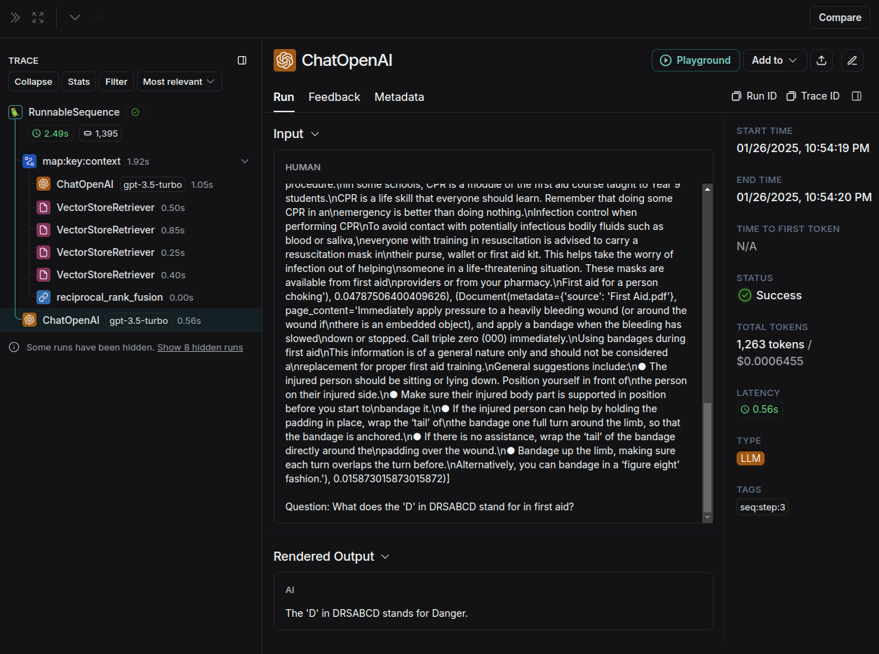
Generation
Ranked Docs to Final Answer

Slide 8
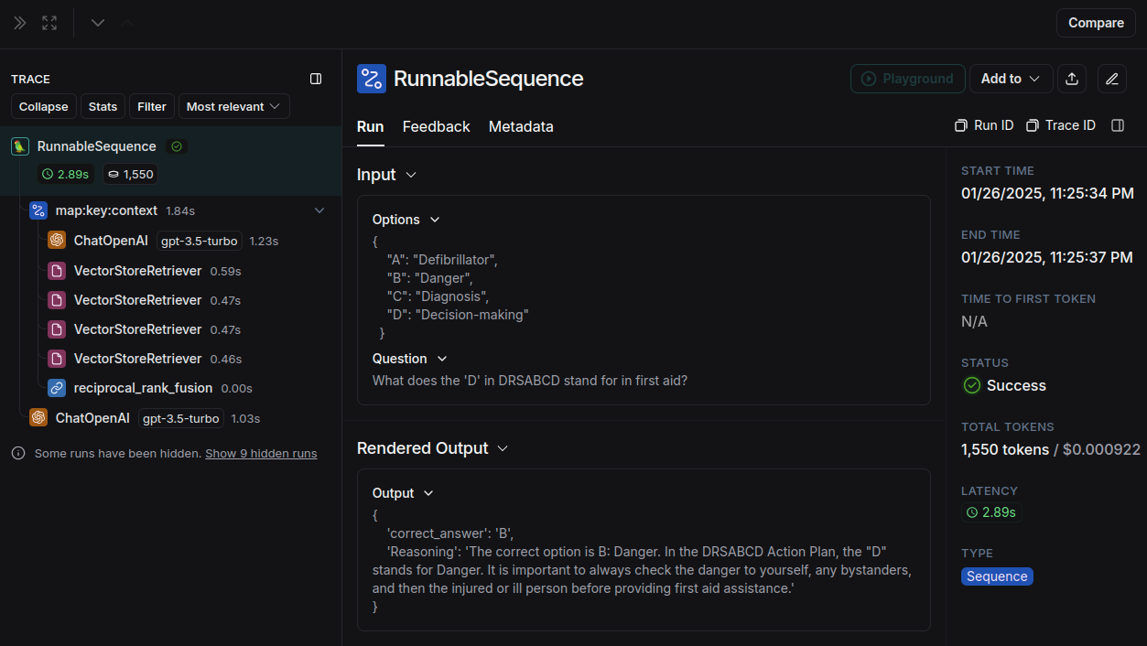
Generation
Final Prompt - To get the output as required

Slide 9
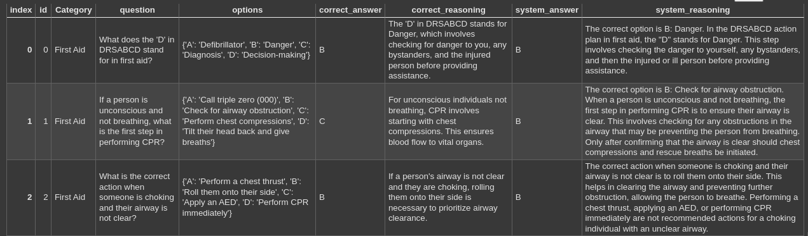
Evaluation
Populate the DataFrame with system-generated answers

Slide 10

Evaluation - system_answer
Confusion Matrix
Class 0 (True: "A")
Predicted "A": 19 times (cm[0][0])
Predicted "B": 0 times (cm[0][1])
Predicted "C": 2 times (cm[0][2])
Predicted "D": 0 times (cm[0][3])
Class 1 (True: "B")
Predicted "A": 0 times (cm[1][0])
Predicted "B": 53 times (cm[1][1])
Predicted "C": 0 times (cm[1][2])
Predicted "D": 0 times (cm[1][3])
Class 2 (True: "C")
Predicted "A": 0 times (cm[2][0])
Predicted "B": 1 time (cm[2][1])
Predicted "C": 17 times (cm[2][2])
Predicted "D": 0 times (cm[2][3])
Class 3 (True: "D")
Predicted "A": 0 times (cm[3][0])
Predicted "B": 0 times (cm[3][1])
Predicted "C": 1 time (cm[3][2])
Predicted "D": 7 times (cm[3][3])

Slide 11
Evaluation - system_answer
Precision and Recall
Precision: 0.9579
Recall: 0.9311
Precision: Out of the cases which our model flages positive, 95.79% were actually posiitive.
Recall: Out of the positive cases in our dataset, 93.11%, our model flag correct as positive.

Slide 12
Evaluation - system_reasoning
Need LLM to figure out context for reasoning, rather here we just calculate ROGUE to find similarity word for word.
ROGUE
Average ROUGE-1 Precision: 0.3117
Average ROUGE-1 Recall: 0.7881
Average ROUGE-1 F1: 0.4396
Average ROUGE-2 Precision: 0.1928
Average ROUGE-2 Recall: 0.5026
Average ROUGE-2 F1: 0.2740
Average ROUGE-L Precision: 0.2597
Average ROUGE-L Recall: 0.6582
Average ROUGE-L F1: 0.3664

Slide 13
Thank you
Jinu Nyachhyon

Slide 14



